Slide 1

Industry Insights for Queens Community District 02
Jacob Bogitsh
6/27/14
Senior Data Analyst Interview Exercise

Slide 2
Objective and Data Sources
The purpose of this exercise was to explore industry insights for Queens Community District 02 (402)
Data Sources provided
2021 U.S. Census Longitudinal Employer-Household Dynamics (LEHD) Workplace Area Characteristics (WAC) data
2020 NYC Community District Shapefile
2020 NYC Census Block Shapefile
Reference documents

Slide 3
Methodology and Challenges
Data was well structured.
Formatting included creating dictionaries, data-type changes, data joins/merges, and key:value functions.
Data was aggregated according to NAICS Industry and DCP Macro Sector.
Charts and maps were created to visualize the data.
Minor challenges included opening .gz file, joining data properly, and mapping dictionary values.

Slide 4
Analysis – DCP Macro Sector and NAICS Title
According to DCP Macro Sector titles Industrial and Office are the industries with the most jobs, followed by Public Administration, Local Services, and Institutional.
Using NAICS Titles, the three most represented industries are:
Administrative and Support and Waste Management and Remediation Services (17%),
Construction (15%),
Public Administration (15%)
Industries with little to no representation include
Agriculture, Forestry, Fishing, and Hunting
Mining, Quarrying, and Oil and Gas Extraction
Utilities
Arts, Entertainment, & Recreation
Management of companies & Enterprises

Slide 5
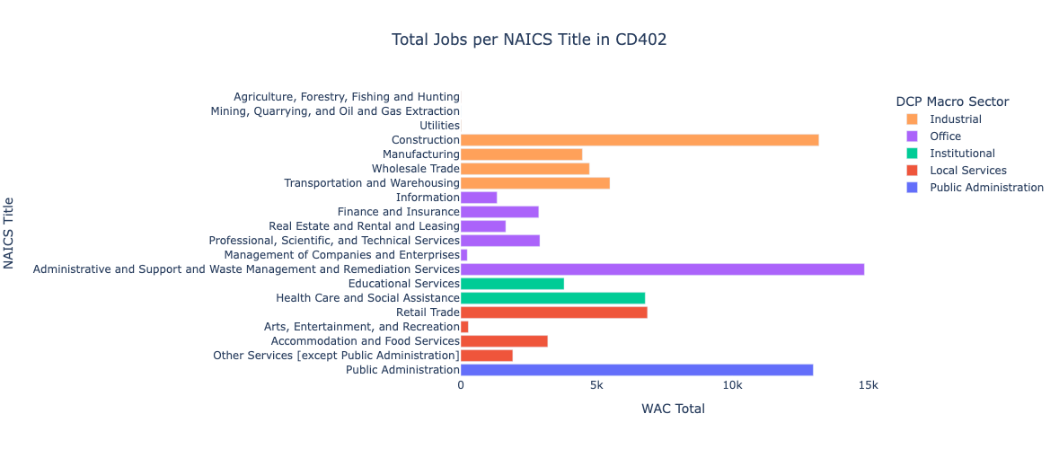
Analysis – DCP Macro Sector and NAICS Title
Notes:
Other industries with sizable representation include Retail Trade, Health Care & Social Assistance, Transportation and Warehousing, Wholesale Trade, and Manufacturing.

Slide 6
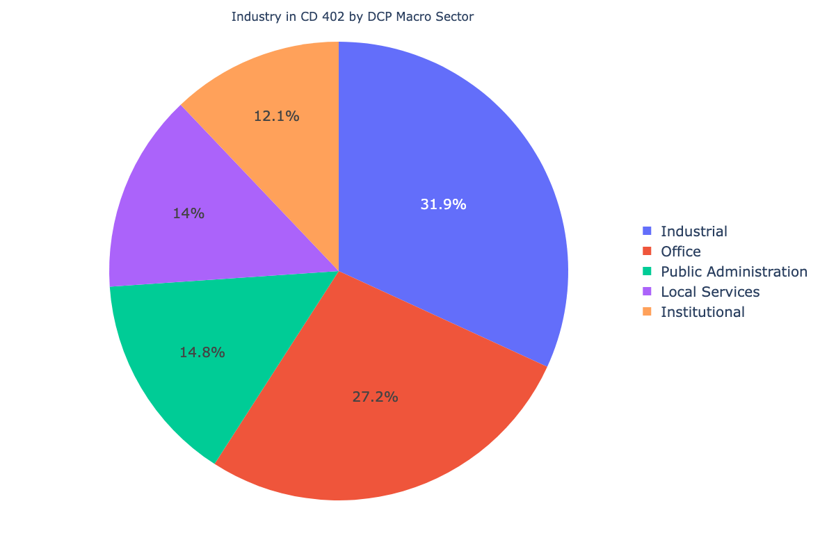
Analysis – DCP Macro Sector

Slide 7
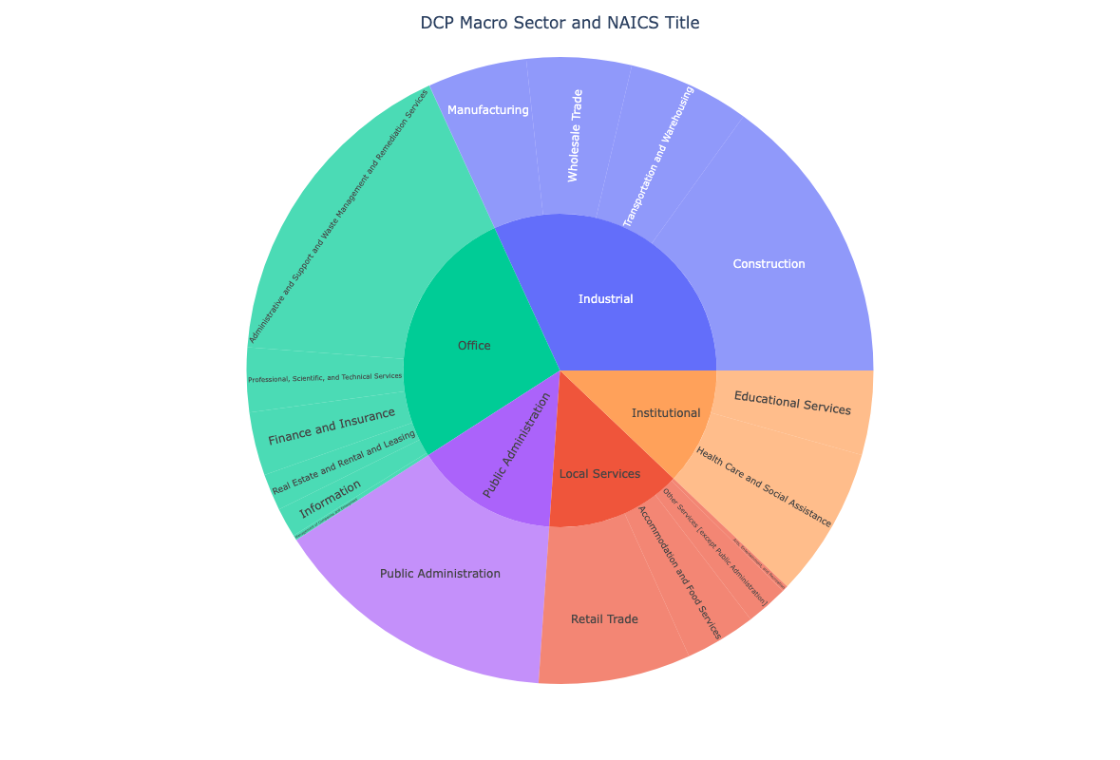
Analysis – DCP Macro Sector and NAICS Title

Slide 8
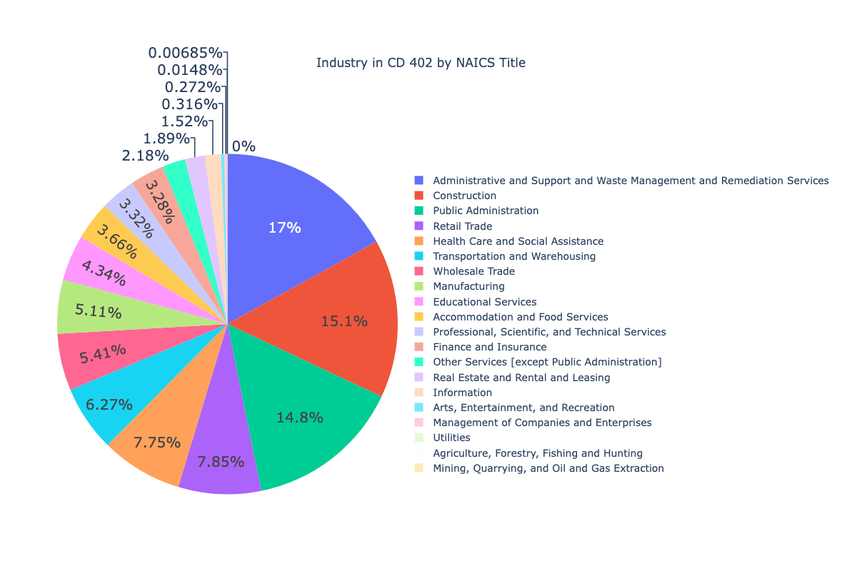
Analysis – NAICS Title

Slide 9
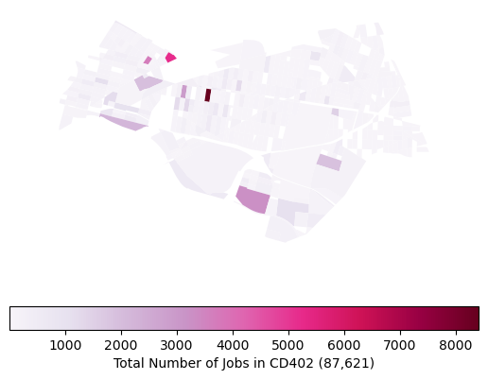
Analysis – Location of jobs Total Number of Jobs
Number of jobs concentrated in the western and southern portions of the district with hot spots near Long Island City.

Slide 10
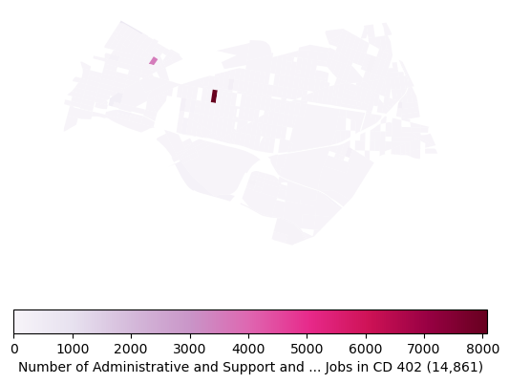
Analysis – Location of jobs Administrative and Support and Waste Management and Remediation Services
Number of Administrative jobs highly concentrated in only a few census blocks.

Slide 11
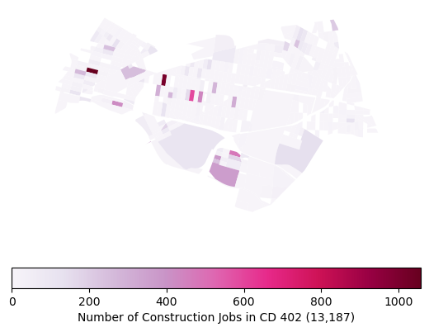
Analysis – Location of jobs Construction
Construction jobs are more evenly dispersed throughout the district.

Slide 12
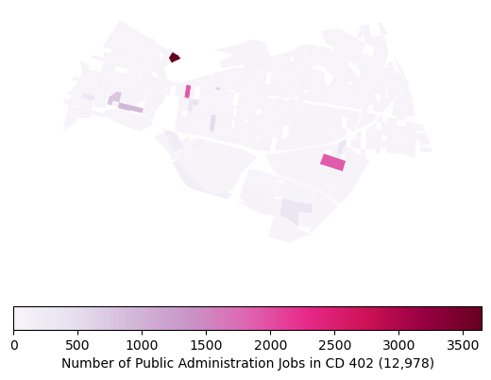
Analysis – Location of jobs Public Administration
Public Administration jobs are concentrated in a few census blocks, but also exhibit some relative dispersion along the southern portion of the district.

Slide 13
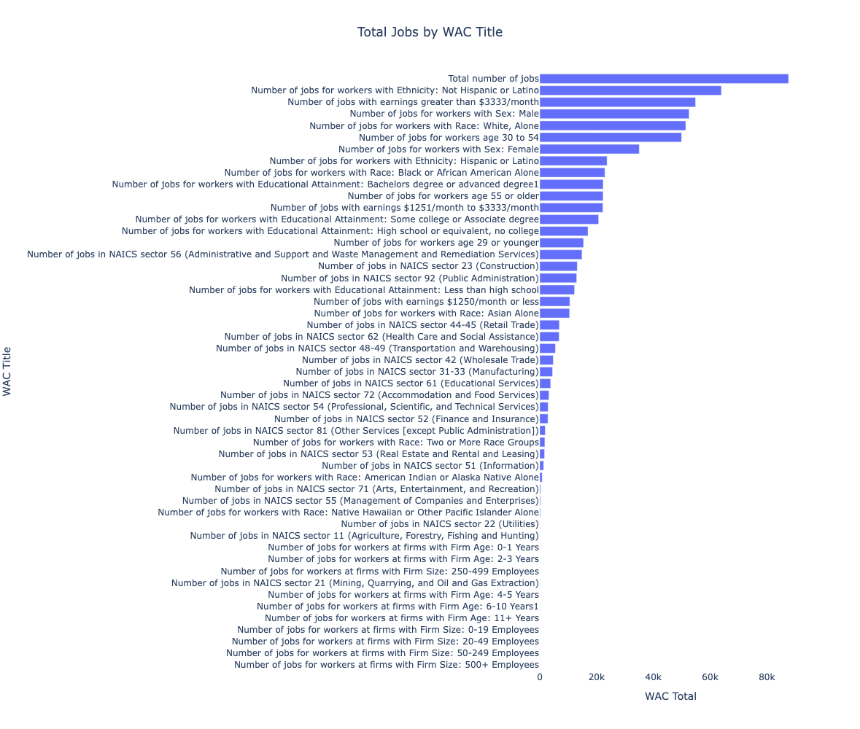
Additional Insights
Majority of jobs in CD402 are
Not Hispanic or Latino
Earnings greater than $3,333/month
Male
White
Ages 30-54

